Slide 1

L
e
g
u
M
a
t
c
i
F
A
L
C
O
N
S
BY

Slide 2

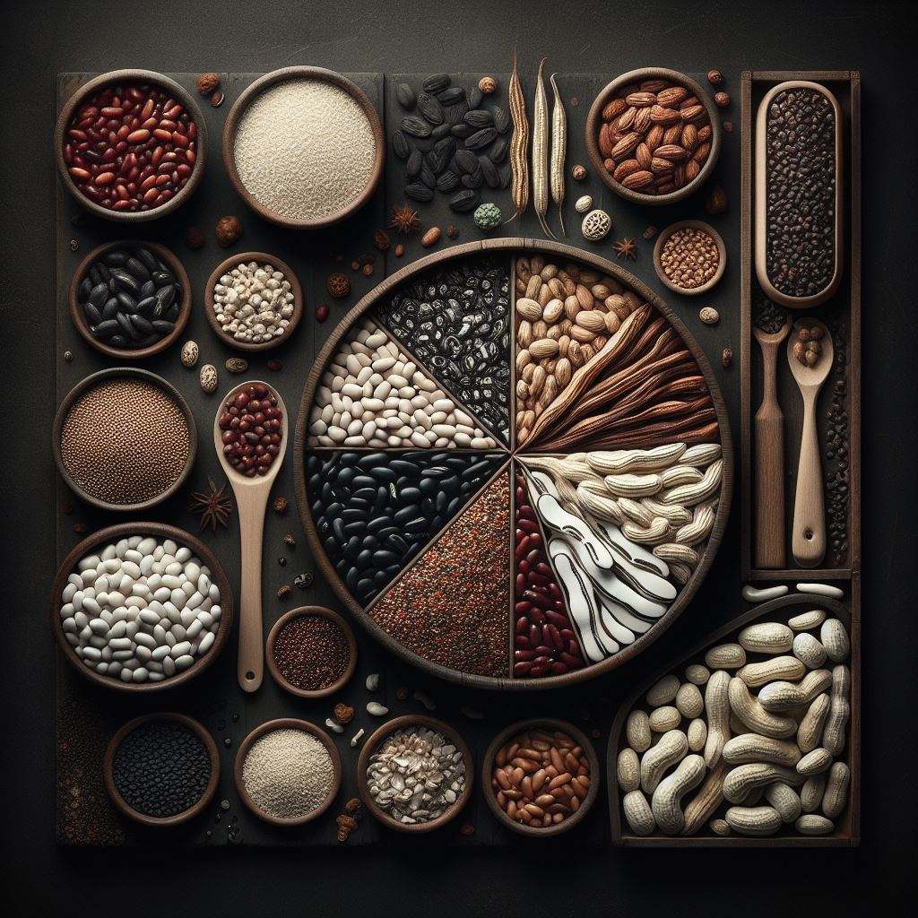
LeguMatic Workplan
Website Imp.
Website Implementation
Machine-learning model design
Machine-learning model implementation
API design and implementation
Testing
Consistent colour tones:
Black, Burlywood, Green and White
Design Squad:
1. Njoroge Kanyagia
Technique: Prototyping
Documentation in all stages

Slide 3
Machine Learning
Pre-requisites:
Datasets
Machine Learning Algorithm
Implemented Model
Data
Handling
Import & clean data
Spliting & training
Model evaluation and improvement
Model Server
ML Team:
1.
Learning

Slide 4
API Integration
Deals with the way our website(frontend) and the model(backend) will communicate with each other.
Factors to consider:
Functionality
Ease of Integration
Scalability
Security
Last step in the cycle

Slide 5
Almost there …
Iterative Development
We’ll involve users and testing in our project to better improve our machine learning model.
Accuracy Score
Our machine model boasts an accuracy score of __%
We promise to deliver a model for you. Ready to go!

Slide 6
Almost there …
Iterative Development
Accuracy Score
Our machine model boasts an accuracy score of __%
We’ll involve users and testing in our project to better improve our machine learning model.
We promise to deliver a model for you. Ready to go!

Slide 7
L
e
g
u
a
t
c
M
i
F
A
L
C
O
N
S
BY

